Slide 1


Fundamentals of RM
RM System and Process
Leadership in RM
Incident Investigation
RM Tools & Challenges
RM in Industry
People & Org.
Application and Perspectives
On Becoming a
Leader in Risk Management
ENGG404 - Lecture
Chapter 1.3:
What is PEAP?
Why is PEAP Important?

Slide 2
Learning Outcomes:
By the end of this lecture, you will be able to:
Explain what PEAP is.
Analyze a loss incident and conclude the impacts on PEAP.
Correlate the importance of PEAP to managing risks in order to prevent losses.
Chapter 1.3: What is PEAP? Why PEAP?
2
Notes:
2

Slide 3
What is PEAP?
Please confer on this question:
What is PEAP?
People, Education, Activity, Professionalism
People, Environment, Assets, Productivity
Property, Education, Assets, Professionalism
Property, Environment, Activity, Production
Chapter 1.3: What is PEAP? Why PEAP?
3
Notes:
3

Slide 4
PEAP is …
People
  Worker or public
  Physical or psychological injury; fatality;
  Occupational illness (acute or chronic) due to exposure to toxic / noxious substances
Assets
  Infrastructure
  Equipment
  Produced goods
  Reputation & Social License
Environment
  Impacts or emissions to air, water, land
  On site, off site
  Spills: bbls oil spilled per million bbls shipped (via railcar, pipeline, shipping)
Productivity
  Barrels of oil produced per day
  Rail cars loaded and shipped
  Can be intermittent or ongoing
Chapter 1.3: What is PEAP? Why PEAP?
4
Notes:
4

Slide 5
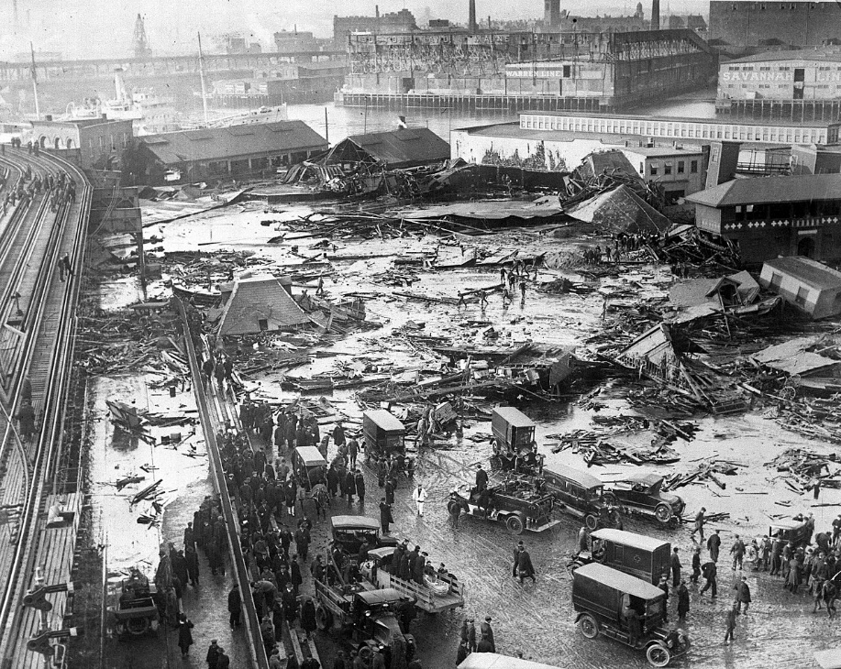
Example of PEAP Losses
Great Boston Molasses Flood of 1919
  People: 21 people drowned. 150 injured
  Environment: Contamination of land & water
  Assets: 2.3 million US gallon tank destroyed and molasses lost
  Production: Ongoing loss of future rum production
Image from: https://en.wikipedia.org/wiki/Great_Molasses_Flood#/media/File:BostonMolassesDisaster.jpg
Chapter 1.3: What is PEAP? Why PEAP?
5
Notes:
5

Slide 6
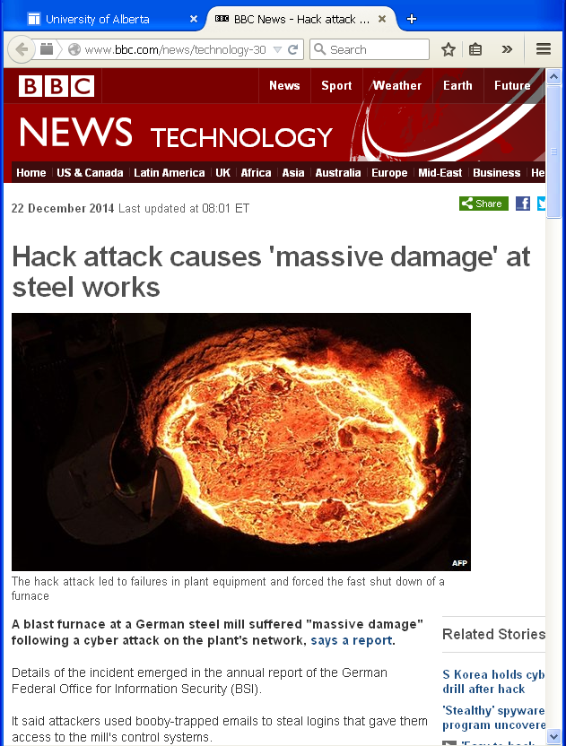
Emerging Concerns: PEAP
Security and Vulnerability | Terrorism and violent attacks Theft, fraud, and embezzlement Unauthorized access to computer systems including network sabotage and espionage
http://www.bbc.co.uk/news/technology-30575104
Chapter 1.3: What is PEAP? Why PEAP?
6
Notes:
6

Slide 7
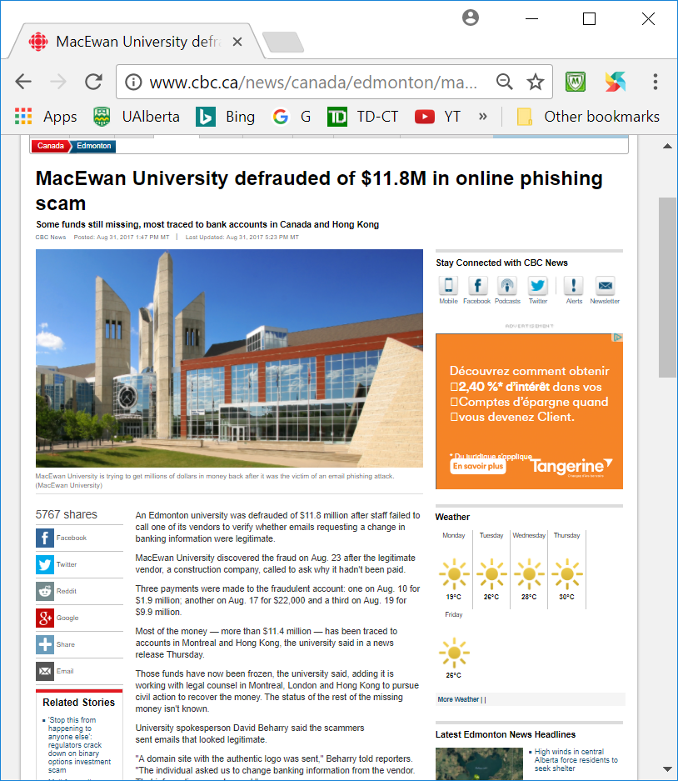
Emerging Concerns: PEAP
http://www.cbc.ca/news/canada/edmonton/macewan-university-phishing-scam-edmonton-1.4270689
Security and Vulnerability | Phishing and scamming
Chapter 1.3: What is PEAP? Why PEAP?
7
Notes:
7

Slide 8
Importance of PEAP:
Please confer on this question – MM:
Why is the concept and quantification of PEAP important?
Chapter 1.3: What is PEAP? Why PEAP?
8
Notes:
8

Slide 9
Importance of PEAP – Concept and Quantification:
It quantifies the extent of a loss incident
Provides the scope of interests for a risk management system
  PEAP losses are reduced with the application of a sound risk management system!
Illustrates the impacts on P(People) and E, A, and P (Productivity):
Safety performance need to improve in Alberta’s workplaces.
Workplace incidents have a significant financial burden on the economy.
These costs only include the costs for healing and rehabilitation
Do not include business losses in assets, productivity, and so on
One should not forget the pain, suffering, and emotional distress that the afflicted workers and their families endure.
These are the data that should motivate us to avoid and minimize loss!
Chapter 1.3: What is PEAP? Why PEAP?
9
Notes:
9

Slide 10
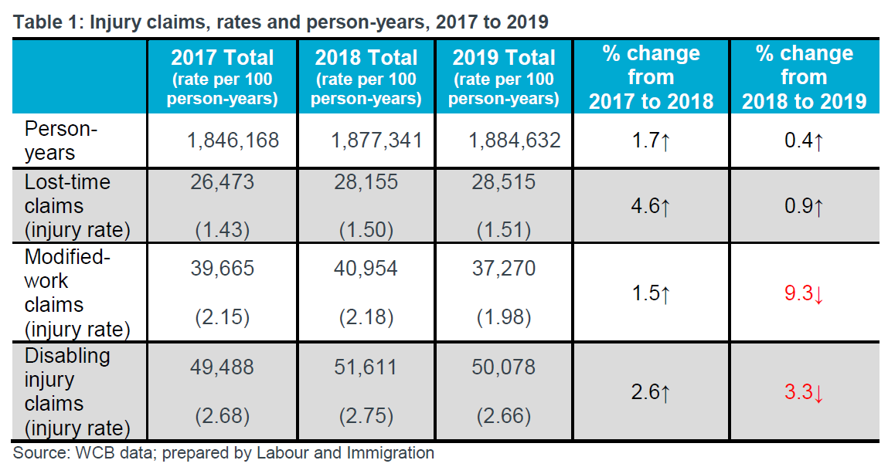
Closer to Home: Alberta Workplace Injury Statistics
About 130 - 140 workers are seriously injured every day
Chapter 1.3: What is PEAP? Why PEAP?
10
Notes:
10

Slide 11
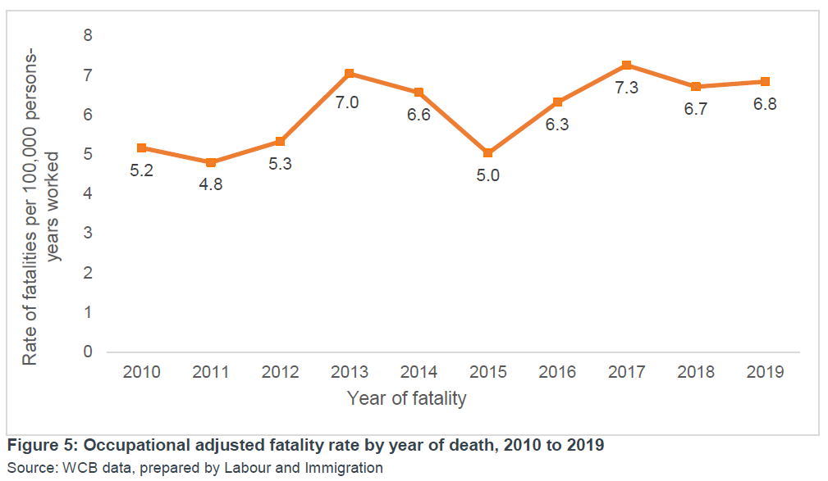
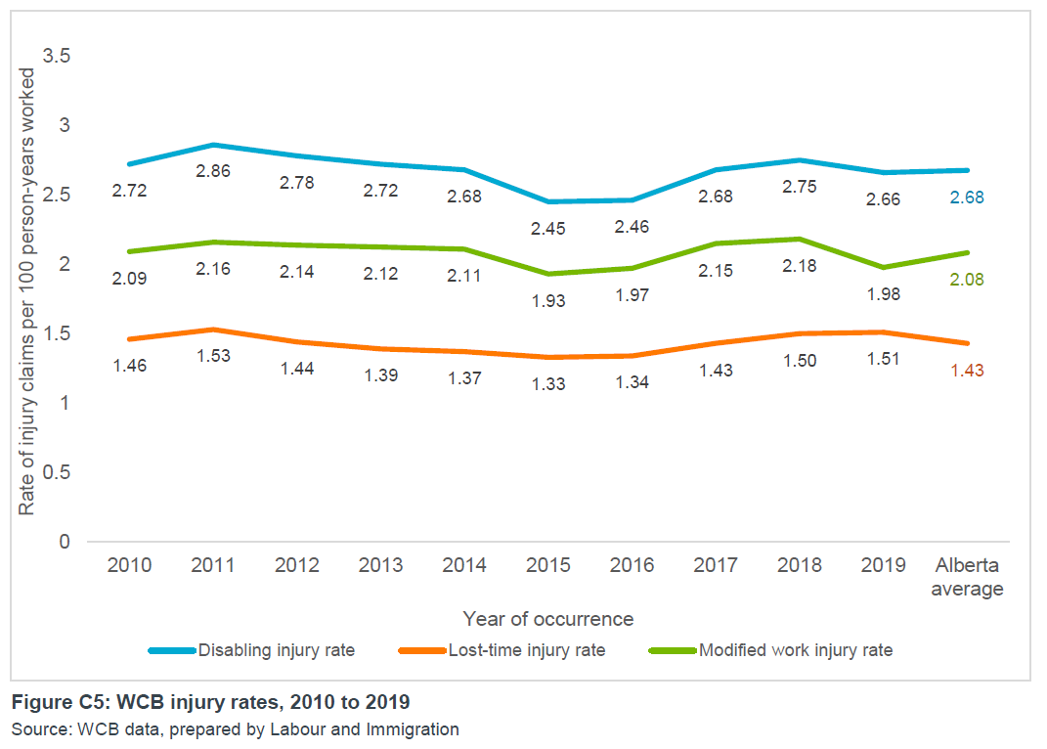
Closer to Home: Alberta Workplace Injury Statistics
The trends are not improving!
Chapter 1.3: What is PEAP? Why PEAP?
11
Notes:
11

Slide 12
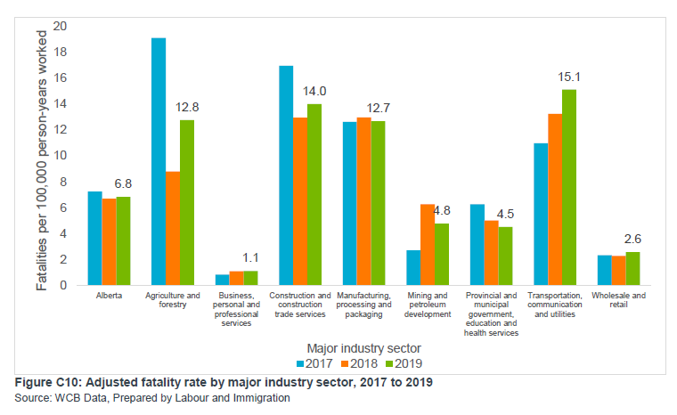
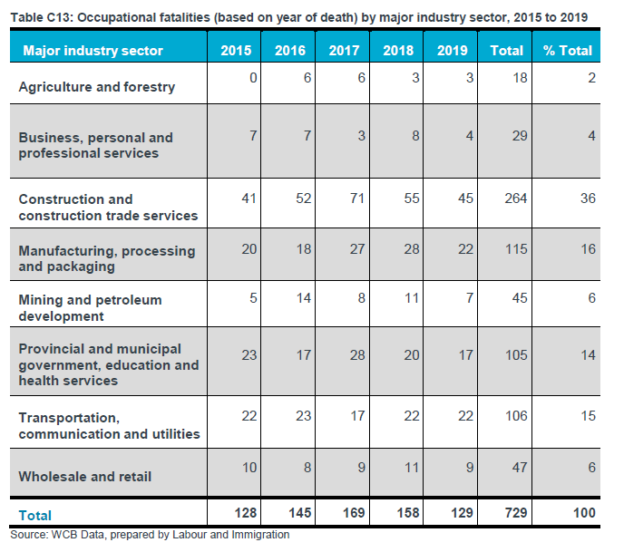
Closer to Home: Alberta Workplace Injury Statistics
The trends are not improving!
Chapter 1.3: What is PEAP? Why PEAP?
12
Notes:
12

Slide 13
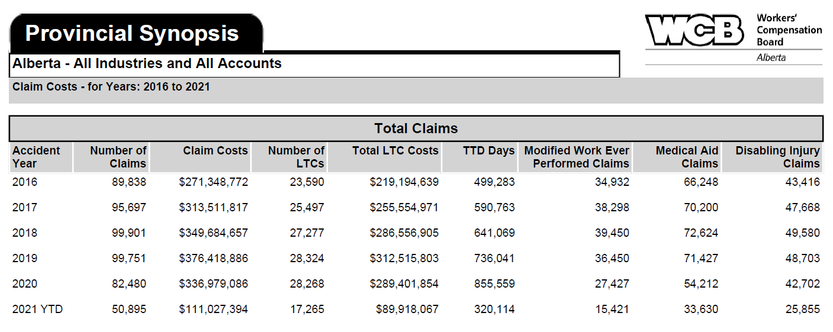
Closer to Home: Alberta Workplace Injury Statistics
The economic losses are significant
Direct transaction claim costs ~$300 million per year!
(most recent data available from WCB)
Certainly another driver to minimises losses!
Chapter 1.3: What is PEAP? Why PEAP?
13
Notes:
13

Slide 14
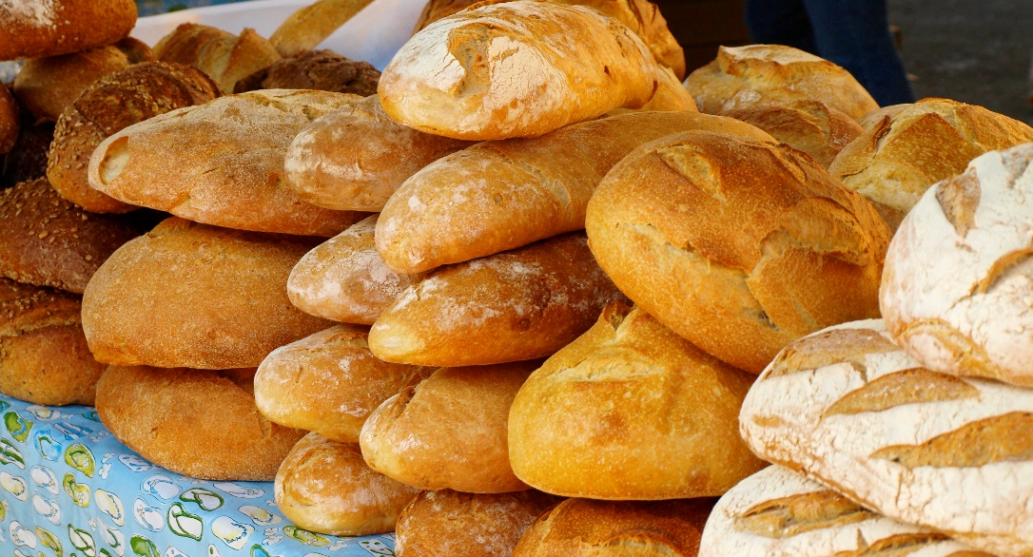
The Loaf of Bread Model:
Let’s talk about minimizing loss …The Loaf of Bread Model:
Case study: Ten (10) loaves of bread are made each day. Cost is 90 cents each. Selling price is $1.00. One day, the baker’s helper dropped a loaf.
Please confer on these questions about this case! (MM)
What is the profit margin on each loaf of bread?
When does the baker make a profit?
Why work at minimizing, preferably avoiding, loss?
Chapter 1.3: What is PEAP? Why PEAP?
14
Notes:
14
$0.90 to produce a loaf, sell for $1. Make $0.10 on each loaf profit. You make 10 loaves per day
Drop one loaf (no 5 second rule!) and have to sell 10 more to make up the loss from that dropped loaf.
How can the baker get the profit back? Make a few more loaves per day if your equipment will handle the increase
Can the baker double production? Market might not bear the increase – need to find an increased market share.
Significant effort is required to increase production – increased time, equipment, etc
Could drop the price to gain market share, but then you have to sell even more loaves to make a profit
If you can prevent the loss in the first place, you’re in a much better financial position

Slide 15
Summary and Key Lessons:
What have we learned?
Every third day in Alberta, a worker doesn’t come home
Implementing a sound and thorough risk management program helps to avoid PEAP losses
As an engineer, you will likely be managing risks with employees, and contractors
In areas such as design, budget, schedule, operations, and maintenance
Consider the potential PEAP losses in each area before making any decision!
Key Lesson:
Avoidance of loss or minimizing loss is the same as …
maximizing profit.
Chapter 1.3: What is PEAP? Why PEAP?
15
Notes:
15

Slide 16
Any questions?
Notes:
16

